Slide 1
AYAN DUTTA
Final Project
3/21/2024 Annual Review

Slide 2
KEYLOGGER AND SECURITY
3/21/2024 Annual Review

Slide 3


AGENDA
INTRODUCTION
PROBLEM STATEMENT ABOUT KEYLOGGER
PROJECT OVERVIEW
END USER
SOLUTIONS AND ITS VALUE PROPOSITION
THE WOW IN THE SOLUTIONS
MODELLING
RESULTS
3/21/2024 Annual Review

Slide 4
INTRODUCTION
A keylogger, sometimes called a keystroke logger, is a type of surveillance technology used to monitor and record each keystroke on a specific device, such as a computer or smartphone.
It takes the information and sends to a hacker using command-and-control (C&C) server.
It can be either hardware or software based. Both types of keyloggers can be used for malicious purposes, including credential theft and identity theft

Slide 5

PROBLEM STATEMENT
PROBLEM:
The problem statement is that installation of hardware keyloggers is difficult without the knowledge of the owner Of the system.
IMPACT:Affects individuals, business, and organizations by compromising the data privacy andSecurity.
3/21/2024 Annual Review

Slide 6


PROJECT OVERVIEW
They are the most common method hackers use to access a users Keystrokes. A software keylogger is put on a computer when the user downloads an infected application. Once installed,the keyloggers monitors the keystrokes on OS you are using.
3/21/2024 Annual Review

Slide 7

WHO ARE THE END USERS?
Keyloggers are used in IT organizations to troubleshoot technical ptoblems with computers and business networks. Families and business people use keyloggers legally to monitor network usage without their users’ direct knowledge.
INDIVIDUALS: Concerned about personal data security and privacy.
SECURITY PROFESSIONALS: Aim to understand and mitigate keylogging threats.
3/21/2024 Annual Review

Slide 8

YOUR SOLUTION AND ITS VALUE PROPOSITION
PREVENT KEYLOGGING ATTACKS:
Update your system.
Install a password manager.
Set up a farewall.
Get antivirus software.
Routinely change your password.
Implement multifactor authentication.
Always be cautions.
Avoid suspicious links and downloads.
3/21/2024 Annual Review

Slide 9

THE WOW IN YOUR SOLUTION
IMPACT: Significant reduction in the likelihood of keylogging through protective measures.INNOVATIVE APPROACH: Combining technical measures with users education for comprehensive protection.
DEMONSTRATION: Real-time demonstration of a simple keylogger to illustrate the threat and the effectiveness of security measure.
3/21/2024 Annual Review
9

Slide 10
MODELLING
INITIALIZATION:
Set up the main GUI window.
Initialize global variables for key logging.
EVENT CAPTURE:
Start capturing key events when the “start” button is pressed
Log key is pressed and release events.
DATA LOGGING:
Continuously update text and Json log files with captured key events.
STOP LOGGING:
Stop capturing key events when the “Stop” button is pressed.
Update the GUI status to indicate the keylogger is stopped.
3/21/2024 Annual Review
10

Slide 11

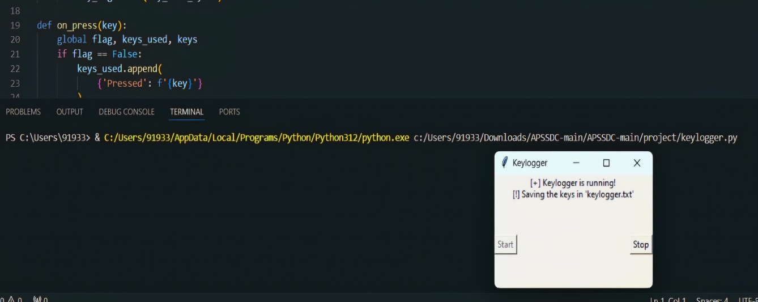
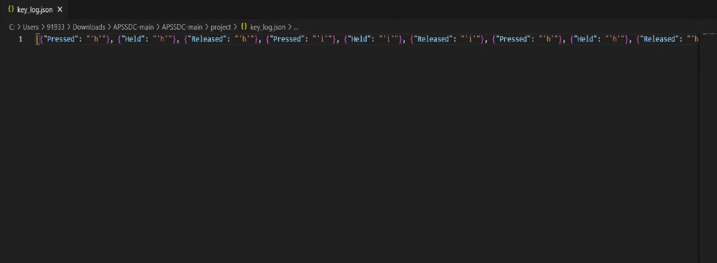
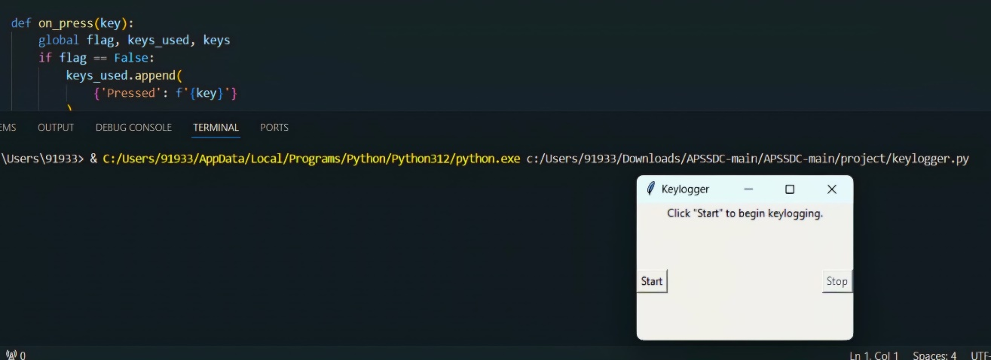
RESULTS
3/21/2024 Annual Review
11

Slide 12
Implemented a keylogger that captures keystrokes and records into both text and JSON files.
Real-time keylogging with start and stop functionality controlledvia simple GUI.
Keyloggers are a potent threat to both individuals and enterprises, with the potential to cause significant harm if left it as undetected.

